Slide 1

MisplaceX PROJECT PROPOSAL
TMP-23-345

Slide 2
TEAM MEMBERS
Superviosr : Dr. Lakmini Abeywardhana
Co-supervisor : Ms. Amali Gunasinghe
Student name | STUDENT ID
Herath H.M.C.S.B | IT19108100
Jasin Arachchi K.T | IT20110802
Gunathilaka S.B.M.B.S.A | IT20028046
Jathurshan S | IT19130408

Slide 3
AGENDA
01
04
02
03
Introduction
conclusion
Objectives
Sub components

Slide 4
INTRODUCTION
Organizations face challenges in maintaining the security of their devices and data.
One of the key challenge is keeping track of devices in an office environment, and ensuring that they are not lost, stolen, or used without authorization.
Our research project aims to implement a real-time monitoring system for devices in an office environment that gives alerts for unauthorized or missing devices.
The system will also include a location tracking module that can reveal the location of misplaced devices.
By implementing this system, organizations can enhance their security posture, prevent data breaches, and ensure that their devices are used only by authorized users.

Slide 5

RESEARCH PROBLEM
The use of IoT devices in server rooms and data centres is becoming increasingly important due to their reliance on them for efficient communication, data storage, and processing. However, their misplacement or unauthorized access can lead to data breaches, downtime, and other negative consequences.

Slide 6
OBJECTIVE
Implement an effective user anomaly detection system to office environments and critical workstations.
Use Artificial intelligence to face Challenging Information Technology market and improve analytical and critical thinking.
Developing a mechanism for managing authorized devices and creating a whitelist of approved devices to ensure only authorized devices are allowed in the office area.
Extraordinary approach to surpass traditional security measures and introducing efficient and low-cost Security monitoring system while using user-friendly interface for easier device management and control.

Slide 7
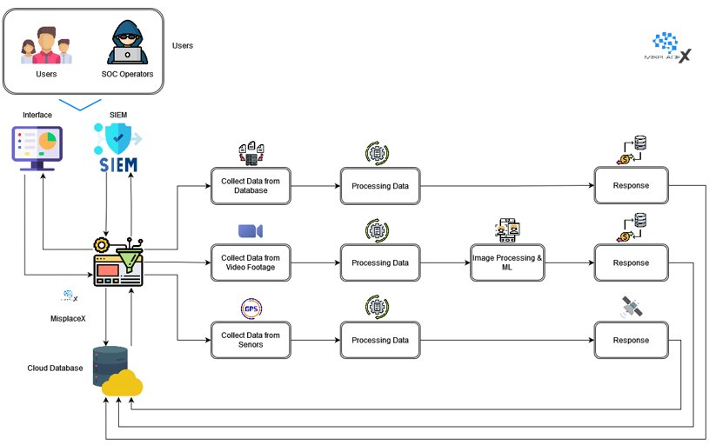
HIGH LEVEL DIAGRAM

Slide 8

01
IT19130408 Jathurshan S BSc (Hons) Degree in Information Technology (specialization in Computer Systems and Network Engineering)
COMPONENT

Slide 9
Implement a real-time monitoring system for devices in an office environment

Slide 10
Background
The security of office environments is a critical concern.
Miss placement of devices is a common problem.
Traditional security measures are expensive and ineffective.
Implementation of a real-time monitoring system using image processing for devices in an office environment can help to improve the security of the environment.

Slide 11
Research Problem
The lack of an accurate and reliable real-time device detection and monitoring system for IoT devices in office environments using image processing and machine learning.
Research Question
How can image processing and machine learning techniques be used to develop an accurate and reliable real-time device detection and monitoring system for IoT devices in office environments, and how effective is this system in detecting unauthorized and missing devices?

Slide 12


RESEARCH GAP
Features | [1] | [2] | [3] | [4] | Ours
Required availability of relevant data
Achieving accurate and reliable IOT device detection
Accurately detect the devices in different lighting conditions
Privacy implications of IoT device monitoring systems in office environments
protect the privacy of the office employees

Slide 13
OBJECTIVES
Sub Objectives
Main Objective
Identify the key factors that can influence the design and effectiveness
Identify the limitations and potential areas for improvement
Conduct experiments to evaluate the effectiveness of the system
Compare the performance with existing systems
Provide recommendations for the enhancing office security
Design and implement a real-time monitoring system using image processing and machine learning for devices in an office environment.

Slide 14
METHODOLOGY
OVERVIEW DIAGRAM
TECHNOLOGY & TOOL SELECTION
PROJECT REQUIREMENTS
WORK BREAKDOWN STRUCTURE

Slide 15
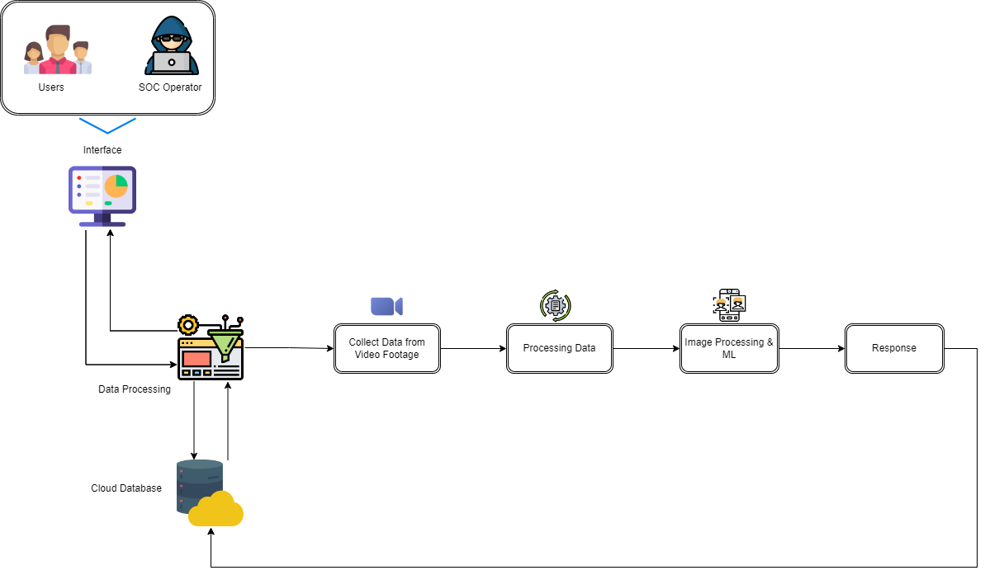
OVERVIEW DIAGRAM

Slide 16
TECHNOLOGY & TOOL SELECTION
Machine learning
Computer vision
Open CV
Simple CV
Image Processing
Cloud computing
TensorFlow
PyTorch
DynamoDB
AWS S3
AWS Cloud9

Slide 17
PROJECT REQUIREMENTS
Functional
Non functional
System
system should capture images of IoT devices in the office environment.
preprocess the images and extract features such as color, texture, and shape.
classify the IoT devices based on their features.
should store the images, features, and classification results in a database
System should be compatible with different types of IoT devices
should have a high-resolution camera with a minimum resolution of 1080p
should have a database for storing images, features, and classification results
should be able to integrate with other office management systems such as access control and security systems
highly accurate in detecting unauthorized and missing devices
Low latency and respond to events in real-time
secure and protect the privacy of the office employees
reliable and have high availability

Slide 18
WORK BREAKDOWN STRUCTURE
Implement a real-time monitoring system for devices in an office environment
Project Initiation
Background study
Documentation
Implementation
Testing
Maintenance
Topic Selection
Litrearture Survey
Topic Registration form
Data gathering
Unit Testing
Upgrade system
Requirement gatherings
Technology survey
Project Charter
Software development
Component Testing
Force reconstitution
Proposal Documnet
Validation
System Testing
Platform modification
Progress Document
Integration with the system
User Testing
Final Documant

Slide 19
REFERENCE
[1]ML Monitoring & Anomaly Detection for IOT & IT Operations | Google Cloud Blog (no date) Google. Google. Available at: https://cloud.google.com/blog/products/ai-machine-learning/event-monitoring-with-explanations-on-the-google-cloud (Accessed: March 20, 2023).
[2]Smith and B. Johnson, "Real-time monitoring for IoT devices in office environments using image processing and machine learning," in Proceedings of the IEEE International Conference on Computer Vision and Pattern Recognition (CVPR), 2023, pp. 1-6.
[3]S. Gupta, S. Ruj, and A. Pal, "Anomaly detection in IoT devices using machine learning: A review," Computer Communications, vol. 154, pp. 139-152, 2020.
[4]J. Kim and K. Kim, "IoT device identification using machine learning for security in smart environments," IEEE Transactions on Consumer Electronics, vol. 64, no. 2, pp. 149-156, 2018.

Slide 20

02
IT19108100 Herath H.M.C.S.B
COMPONENT
BSc (Hons) in Information Technology Specialising in Cyber Security

Slide 21
INTRODUCTION
Whitelist of authorized devices in IT device detection and monitoring systems in office environments
My research component is focused on developing a whitelist mechanism for authorized devices in IT device detection and monitoring systems in office environments.
The mechanism will provide granular control over device access, logging and reporting device access attempts, and blacklisting removed devices to prevent unauthorized access.
I am also contributing to the project by processing image data and creating the interface and database.
The proposed mechanism aims to significantly improve the security posture of IT device detection and monitoring systems in office environments.

Slide 22
RESEARCH GAP
There are existing studies done on the topic of “whitelist of authorized devices ”
Lack of detailed mechanism for controlling access to devices based on a whitelist (Bursztein et al., 2014)
Lack of attention given to the management of authorized devices (Joshi et al., 2015)
Not addressing the specific challenge of managing authorized devices (Cheung et al., 2017)
Not addressing the challenge of managing authorized devices and ensuring only approved devices are allowed in the office environment (Xu et al., 2019)
The novelty of our proposed work
Developing a mechanism for managing authorized devices and creating a whitelist of approved devices to ensure that only authorized devices are allowed in the office area.
Providing more granular control over device access, logging and reporting device access attempts, and blacklisting devices that have been removed from the office environment to prevent unauthorized access.
Enabling real-time reporting and notifications on device access attempts to enable more proactive threat detection and response.

Slide 23
SYSTEM COMPARISON
System Features | [1] | [2] | [3] | [4] | Ours
Whitelist of authorized devices
Mechanism for users to add devices to whitelist
Access control based on whitelist
Blacklisting of removed devices
Custom permissions for devices
Real-time reporting
Bursztein et al. (2014): "Detecting mobile devices on a corporate network“
Joshi et al. (2015): "A device fingerprinting-based approach for identifying smartphones“
Cheung et al. (2017): "MobiSec: A mobile security system with customizable security policies“
Xu et al. (2019): "Mobile device security policies for small and medium-sized enterprises: An empirical study"

Slide 24
Main Objective
Developing a mechanism for managing authorized devices and creating a whitelist of approved devices to ensure only authorized devices are allowed in the office area.
Processing all data for more efficient device monitoring and detection.
Creating a user-friendly interface for easier device management and control.
Sub-Objectives
Develop a mechanism for managing authorized devices.
Create a whitelist of approved devices to ensure only authorized devices are allowed.
Implement a system to control access based on the whitelist.
Provide granular control over device access.
Log and report device access attempts and other relevant events.
Blacklist devices that have been removed from the office environment to prevent unauthorized access.
Ensure device capabilities match the organization's policies.
Process image data and display it in the interface.

Slide 25
METHODOLOGY
OVERVIEW DIAGRAM
TECHNOLOGY & TOOL SELECTION
PROJECT REQUIREMENTS
WORK BREAKDOWN STRUCTURE

Slide 26
OVERVIEW DIAGRAM

Slide 27
TECHNOLOGY & TOOL SELECTION
Programming languages
Libraries
Python
JavaScript
OpenCV
TensorFlow
Matplotlib
NumPy
Flask
development environments
interactive computing platforms
Visual Studio Code
PyCharm
Jupyter Notebook
Jupyter Notebook
MATLAB
Google Colaboratory

Slide 28
PROJECT REQUIREMENTS
Functional
Non functional
System
Develop a whitelist of authorized devices
Control device access based on the whitelist
Log and report device access attempts
Blacklist devices that have been removed from the office environment
Process and display image data in the interface
Develop a database to store device information
Ensure system reliability and availability
Ensure data privacy and security
Provide real-time reporting and notifications on device access attempts
Ensure user-friendliness of the interface
Support multiple platforms (Windows, Linux, macOS)
Support multiple browsers (Chrome, Firefox, Safari)
Support multiple device types (mobile, laptop, desktop)
Utilize efficient algorithms for image processing and data processing

Slide 29
WORK BREAKDOWN STRUCTURE
Whitelist of authorized devices in IT device detection and monitoring systems
Project Initiation
Background study
Documentation
Implementation
Testing
Maintenance
Topic Selection
Litrearture Survey
Topic Registration form
Hardware setup
Unit Testing
Upgrade system
Requirement gatherings
Technology survey
Project Charter
Software development
Component Testing
Force reconstitution
Proposal Documnet
Validation
System Testing
Platform modification
Progress Document
Integration with the system
User Testing
Final Documant

Slide 30
REFERENCE
[5]Bursztein, E., Martin, J., Mitchell, J., Robertson, W., & Ziring, D. (2014). Design and implementation of a usable whitelisting system. In Proceedings of the 23rd USENIX Security Symposium (pp. 827-842).
[6]Joshi, A., Singh, A., & Joshi, K. D. (2015). A review of device whitelisting techniques for securing BYOD environments. In 2015 IEEE 2nd International Conference on Cyber Security and Cloud Computing (pp. 118-123). IEEE.
[7]Cheung, H. T., Ku, W. S., & Chan, A. T. (2017). A policy-based trust management model for device-to-device communication in IoT. IEEE Transactions on Information Forensics and Security, 12(7), 1551-1566.
[8]Xu, L., He, W., Li, S., & Liu, J. (2019). Mobile device management: A review of security threats, countermeasures and trends. Future Generation Computer Systems, 97, 848-870.

Slide 31

03
IT20028046 Gunathilaka S.B.M.B.S.A
COMPONENT
BSc (Hons) in Information Technology Specialising in Cyber Security

Slide 32
Build a module that can reveal the location of the misplaced devices when the system identified a device has misplaced from it’s intended place .

Slide 33
INTRODUCTION
trigger when the system has identified a device is misplaced.
Use of hardware and software technologies to locate the device.
It will send a signal to the device which will respond with its location.
Use combination of location tracking technologies.
Show the exact location on a map.

Slide 34
RESEARCH GAP
There are existing studies done on the topic of “locating misplaced devices”
ZigBee-based positioning system[1].
Bluetooth-based approach for locating misplaced objects[2].
UWB-based wireless sensor network for locating misplaced objects[3].
An indoor localization and tracking system based on ultra-wideband technology[4].
The novelty of our proposed work
Use of both UWB and GPS technologies.
Integration with an Arduino board.
Integration with a map of the office.
switch to GPS mode if a misplaced device is not in the UWB range.
specifically designed for use in critical office areas.

Slide 35
RESEARCH GAP
Features | [1] | [2] | [3] | [4] | Ours
Applicable for short ranges
Applicable for long(outdoor) ranges
Use of UWB technology
Build for critical office areas
penetrate walls and obstacles

Slide 36
Main Objective
Locating misplaced devices is to ensure that all devices in critical office areas such as data centers and server rooms are properly placed and in their designated locations.
Sub-Objectives
Accurate identification of misplaced devices:
Real-time tracking
User-friendly interface

Slide 37
METHODOLOGY
OVERVIEW DIAGRAM
TECHNOLOGY & TOOL SELECTION
PROJECT REQUIREMENTS
WORK BREAKDOWN STRUCTURE

Slide 38
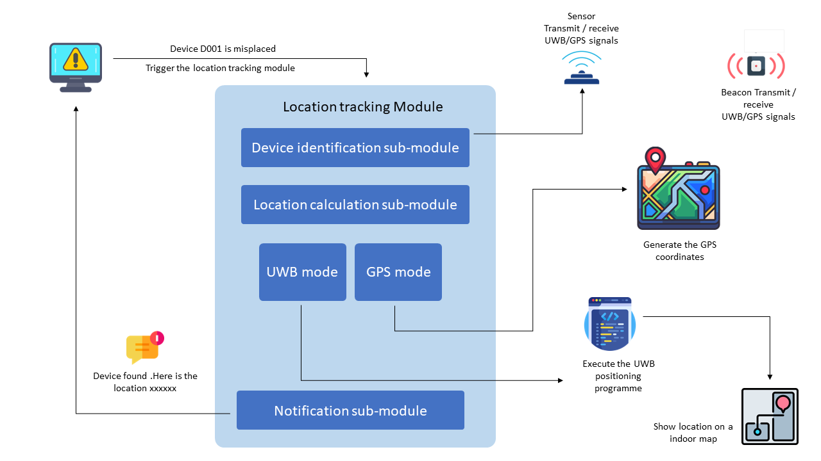
OVERVIEW DIAGRAM

Slide 39
TECHNOLOGY & TOOL SELECTION
Programming languages
Libraries
C/C++
JavaScript
Python
Arduino libraries
NumPy
Pandas
Matplotlib
development environments
interactive computing platforms
Arduino IDE
Visual Studio Code
PyCharm
Jupyter Notebook
MATLAB

Slide 40
PROJECT REQUIREMENTS
Functional requirements
NON-Functional requirements
System requirements
switch to GPS mode when the misplaced device is not in the UWB range.
accurately locate the device using GPS/UWB technologies.
display the location of the device on a map.
notify to the admin the misplace device location.
Low latency in displaying the device's location.
highly accurate in locating the devices.
reliable and operate 24/7 without downtime.
display a map of the area and overlay device locations on it.
send notifications to the admin

Slide 41
WORK BREAKDOWN STRUCTURE
build a module that can reveal the location of the misplaced devices
Project Initiation
Background study
Documentation
Implementation
Testing
Maintenance
Topic Selection
Litrearture Survey
Topic Registration form
Hardware setup
Unit Testing
Upgrade system
Requirement gatherings
Technology survey
Project Charter
Software development
Component Testing
Force reconstitution
Proposal Documnet
Validation
System Testing
Platform modification
Progress Document
Integration with the system
User Testing
Final Documant

Slide 42
REFERENCE
[1]"A ZigBee-based positioning system for locating misplaced objects in an indoor environment" by F.-Y. Shih and Y.-C. Chang (2011)
[2]"A Bluetooth-based approach for locating misplaced objects in indoor environments" by H. Chen, W. Zhang, and L. Chen (2015)
[3]"A UWB-based wireless sensor network for locating misplaced objects in indoor environments" by C. Zhang, Y. Dong, and Y. Zhang (2016)
[4]"An indoor localization and tracking system based on ultra-wideband technology" by Y. Chen, S. Li, and X. Li (2019)

Slide 43


04
IT20110802 Jasin Arachchi K.T
COMPONENT
BSc (Hons) in Information Technology Specialising in Cyber Security

Slide 44
INTRODUCTION
Implement a mechanism to monitor and track user activity on their devices within the office environment
identifies abnormal behaviour, determines if it has security implications, and alerts security teams using User and Entity Behaviour Analytics
Integration with security operations centre
Develop a reporting mechanism to provide relevant information and data to the security operations center

Slide 45
RESEARCH GAP
There are existing studies done on the topic of “Reducing False Positives Of User-to-Entity First-Access Alerts for User Behaviour Analytics”
Similarity | Difference
users' behaviors monitoring and analysis used to detect anomalies. | Use image processing video footage results to analyzing alerts
monitor and analyze events through networks and systems | Gather data from several resources and implement in SIEM and analyzing to remove false positives alerts.

Slide 46
Novelty
Implement a mechanism to monitor and track user activity with image processing, User availability tracking and User and Event Behavioural Analytics in office environment
Extract all the security anomalies to one place; SIEM and analyse to filter false positives .

Slide 47
OBJECTIVES
Check user availability
generate alerts & SIEM
Check availability of the authorized user in critical workstation.
Gather suspicious user behaviour, ,vedio footage results and UEBA alerts to SIEM.
Response and Investigation
Reporting
Response and investigate Alerts in the SIEM and compare alerts that came from different sources and dismiss false positive alerts.
Analyzing report history ,Alert trends and create final report

Slide 48
METHODOLOGY
OVERVIEW DIAGRAM
TECHNOLOGY & TOOL SELECTION
PROJECT REQUIREMENTS
WORK BREAKDOWN STRUCTURE

Slide 49
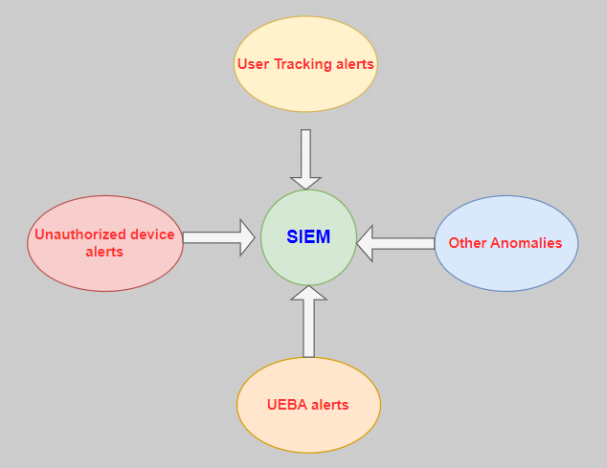
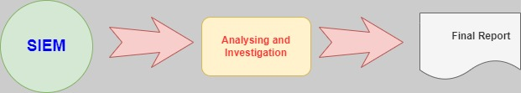
OVERVIEW DIAGRAM

Slide 50
TECHNOLOGY & TOOL SELECTION
SIEM
Authorized user tracking
Alien vault ,ELK Stack or OSSEC
Beacon and Bluetooth
UABE
Reporting
Rapid 7 ,Machine learning
Clearpoint, Microsoft office suite

Slide 51
PROJECT REQUIREMENTS
Functional requirements
NON-Functional requirements
System requirements
Accurately use Bluetooth technology to user tracking
Send signal user and verify user location after anomaly detected
SIEM working Accurately and Filter False positives
reliable and operate 24/7 without downtime.
Availability of the SIEM and data extracting.
send notifications to the admin

Slide 52
WORK BREAKDOWN STRUCTURE
build a module that can reveal the location of the misplaced devices
Project Initiation
Background study
Documentation
Implementation
Testing
Maintenance
Topic Selection
Litrearture Survey
Topic Registration form
Hardware integration
Unit Testing
Upgrade system
Requirement gatherings
Technology survey
Project Charter
SIEM integration
Component Testing
Force reconstitution
Proposal Documnet
Validation and Analyzing
System Testing
Platform modification
Progress Document
Alert Positive alerts to system and final report.
User Testing
Final Documant

Slide 53
REFERENCE
[1]"Reducing False Positives Of User-to-Entity First-Access Alerts for User Behavior Analytics" by Baoming Tang (2017)
[2]"A Bluetooth-based approach for locating misplaced objects in indoor environments" by H. Chen, W. Zhang, and L. Chen (2015)
[3]"Measuring the Effectiveness of User and Entity Behavior Analytics for the Prevention of Insider Threats" October 2021 Xi'an Jianzhu Keji Daxue Xuebao/Journal of Xi'an University of Architecture & Technology

Slide 54

CONCLUSION
Gantt Chart
Business Potential and Commercialization
Conclusion

Slide 55
GANTT CHART
 |  | April- May |  |  | MAY-JULY |  |  | July -SEPT |  |  | SEPT-NOv
INITIATIVE | OBJECTIVE | 1 | 2 | 3 | 1 | 2 | 3 | 1 | 2 | 3 | 1 | 2 | 3
Project Proposal submission | Overview to Project and describe research components.
Implementation | Data Analyse, Data processing and hardware implementations.
System Integrations | SIEM Integration and alert system integration
Testing and Maintenance | Test each component and whole project and prepare product to sell in the market
Final project report and viva | Final stage of the project and end of the research

Slide 56
Business Potential and Commercialization
Selling the System
Licensing the Technology
Providing Consulting Services
Partnerships
Notes:
I am going to describe this section.

Slide 57
CONCLUSION
System gives alerts for unauthorized or missing devices.
Module that can reveal the location of misplaced devices.
System help organizations to maintain better control over their devices and prevent theft, loss, or unauthorized access.
real-time alerts and notifications to users, allowing them to take immediate action in case of unauthorized or missing devices.
The research project can have significant implications for the security and productivity of modern workplaces. By implementing such a system, organizations can improve their security posture and reduce the risk of data breaches, as well as save time and resources by reducing the need for manual inventory tracking.

Slide 58
THANKS!

